Slide 1
FIELD PROJECT
SEC: 2
BATCH: 1
SUBMITTED BY :
241FA04133
241FA04203
241FA04B20
241FA04C62
SUBMITTED TO :
CH.AMERESH

Slide 2

VisionTrack AI
Smart Attendance Management — A Unified Face Recognition System Built for Educational Institutions

Slide 3

The Problem with Manual Attendance
⏱ Time-Consuming
🎭 Proxy Attendance
Roll calls waste valuable class time — up to 10 minutes per session across hundreds of classes.
Students mark absent peers as present, making traditional attendance fundamentally unreliable.
📂 Record Errors
Manual entry leads to lost data, miscounts, and inconsistent reporting with no audit trail.

Slide 4
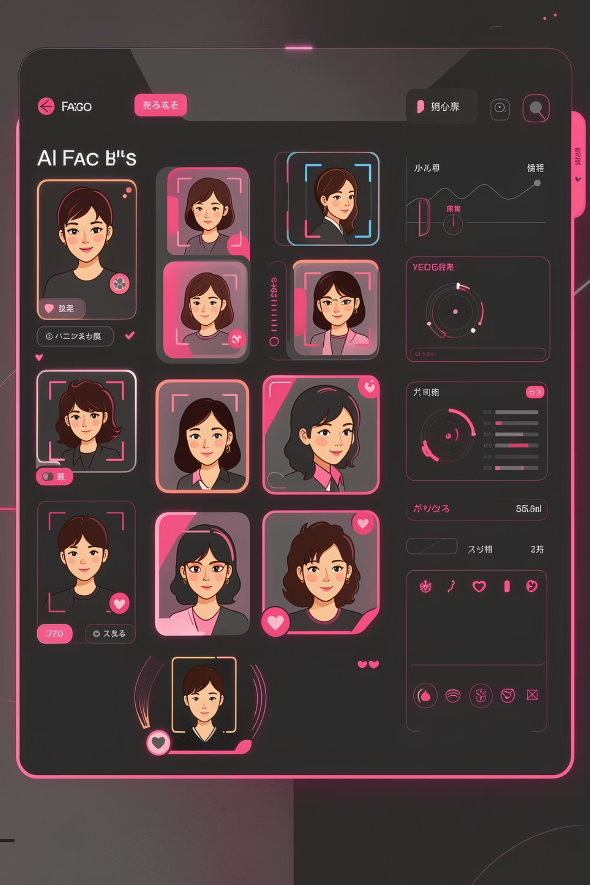

The Solution: VisionTrack AI
An intelligent, camera-powered attendance platform that automatically identifies students in real time — eliminating proxies, saving time, and generating accurate, auditable records with zero manual input.
AI-driven recognition replaces the entire manual workflow from check-in to report generation.

Slide 5

USER EXPERIENCE
Student Registration Portal
The entry portal — built with semantic HTML5 and CSS3 — guides students through a streamlined onboarding flow:
01
02
03
Identity Input
Face Capture
Profile Creation
Student enters name, ID, and department credentials.
Webcam activates to collect facial image samples.
Data is stored and the student profile becomes training-ready.

Slide 6
Core Dashboard Features
Three powerful pillars power the VisionTrack AI experience:
Member Registration
Model Training
Live Recognition
Capture and store facial data for each student with guided prompts, ID linking, and real-time camera feedback.
Trigger the AI training pipeline directly from the dashboard — updating the recognition model with newly registered faces.
Real-time camera feed identifies registered students instantly, marking attendance with timestamps automatically.

Slide 7

TECHNICAL STACK
Built on Modern Web Technologies
VisionTrack AI is a lightweight yet powerful stack — deployable on any institution's infrastructure with minimal overhead.
Front-End
Application Logic
AI Integration
HTML5, CSS3 Grid, FontAwesome icons, Segoe UI typography
Vanilla JavaScript handling UI state, session control, and camera API
Face recognition model interface via backend API, trainable on demand

Slide 8
UI/UX Design Philosophy
Responsive CSS Grid
Clean Typography
Fluid layouts adapt to any screen size — from admin desktops to classroom tablets.
"Segoe UI" provides a professional, readable interface consistent with enterprise software standards.
Interactive Status Alerts
Dark-Slate Aesthetic
Color-coded feedback (success, warning, error) gives users instant, contextual system responses.
A cohesive dark color scheme reduces eye strain and projects a modern, professional brand identity.

Slide 9

End-to-End Attendance Workflow
Attendance Marked
Face Capture
Model Training
Live Detection
Identity Match
From the moment a student enters the room to the final attendance log entry, VisionTrack AI handles every step — with no instructor intervention required. The pipeline runs in seconds, ensuring classes begin on time.

Slide 10

SECURITY & ACCESS CONTROL
Protected at Every Layer
VisionTrack AI is designed with institutional security in mind — access is restricted and sessions are actively managed.
Password-Protected Entry
Session Management
Role-Based Access
Only authorized administrators can access the dashboard via credential-gated login.
JavaScript-driven session logic enforces automatic logout on inactivity, preventing unauthorized access.
Instructors and admins operate within defined permission boundaries — students cannot self-modify records.

Slide 11

Conclusion & Future Scope
VisionTrack AI delivers a production-ready foundation for intelligent attendance — with a clear roadmap for growth:
Database Integration
Cloud Analytics
Connect to institutional ERPs (e.g., MySQL, Firebase) for persistent, queryable attendance records.
Real-time dashboards surfacing attendance trends, absentee alerts, and compliance reports.
Mobile Expansion
Progressive Web App (PWA) support enabling attendance monitoring from any device, anywhere.

Slide 12


